Slide 1
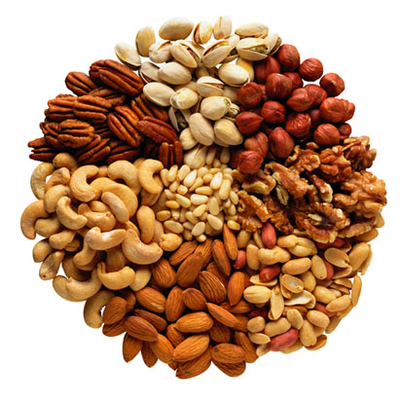
QUIZ FOR NUTS
Thursday 21st March 2013

Slide 2
Celebrating TV Quiz Shows
A Question of Sport
University Challenge
Sale of the Century
Bullseye
Quizball
Generation Game
Pointless
Winner Takes All

Slide 3

A Question of Sport
2nd December 1968 – present day

Slide 4
Picture Board
There are 20 GB London 2012 Gold Medal winners on the picture board. You get 10 pts for each you identify and a bonus 10 pts if you also name their event.
I predict you will get 310 pts

Slide 5
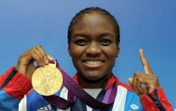
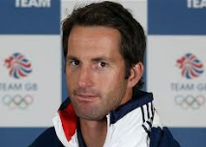
Question of Sport
GB London Olympic Gold Medal Winners
10 pts per competitor (Bonus 10 pts for event)
1 | 2

Slide 6
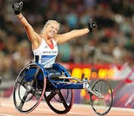
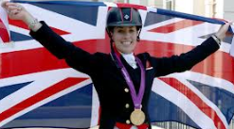
Question of Sport
GB London Olympic Gold Medal Winners
10 pts per competitor (Bonus 10 pts for event)
3 | 4

Slide 7
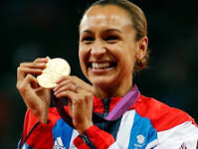
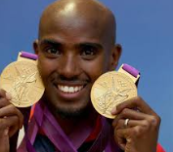
Question of Sport
GB London Olympic Gold Medal Winners
10 pts per competitor (Bonus 10 pts for event)
5 | 6

Slide 8
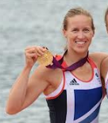
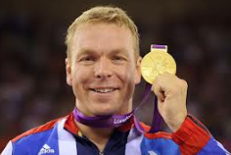
Question of Sport
GB London Olympic Gold Medal Winners
10 pts per competitor (Bonus 10 pts for event)
7 | 8

Slide 9

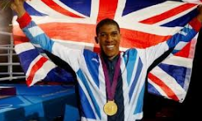
Question of Sport
GB London Olympic Gold Medal Winners
10 pts per competitor (Bonus 10 pts for event)
9 | 10

Slide 10
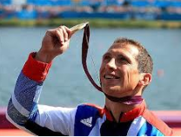
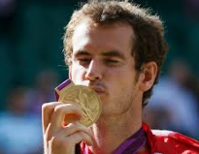
Question of Sport
GB London Olympic Gold Medal Winners
10 pts per competitor (Bonus 10 pts for event)
11 | 12

Slide 11
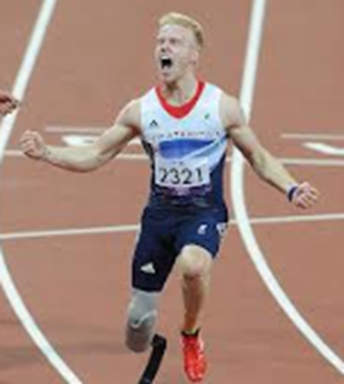
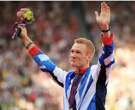
Question of Sport
GB London Olympic Gold Medal Winners
10 pts per competitor (Bonus 10 pts for event)
13 | 14

Slide 12
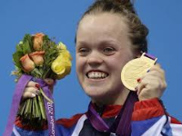
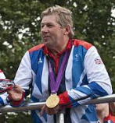
Question of Sport
GB London Olympic Gold Medal Winners
10 pts per competitor (Bonus 10 pts for event)
15 | 16

Slide 13

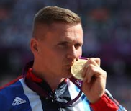
Question of Sport
GB London Olympic Gold Medal Winners
10 pts per competitor (Bonus 10 pts for event)
17 | 18

Slide 14
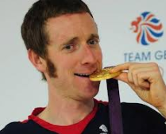
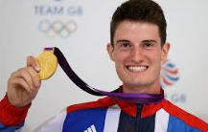
Question of Sport
GB London Olympic Gold Medal Winners
10 pts per competitor (Bonus 10 pts for event)
19 | 20

Slide 15
No cheating; the answers are on the next slide.

Slide 16
10 pts per competitor + 10 pts per event
1 | Nicola Adams | Boxing | 11 | Ed McKeever | Kayak
2 | Ben Ainslie | Sailing | 12 | Andy Murray | Tennis
3 | Hannah Cockroft | 100/200 | 13 | Jonnie Peacock | 100m
4 | Charlotte Dujardin | Dressage | 14 | Greg Rutherford | Long Jump
5 | Jessica Ennis | Heptathlon | 15 | Ellie Simmonds | Swimming
6 | Mo Farrah | 5000/10000 | 16 | Nick Skelton | Show Jumping
7 | Helen Glover | Rowing | 17 | Laura Trott | Cycling
8 | Chris Hoy | Cycling | 18 | David Weir | Athletics
9 | Jade Jones | Taekwondo | 19 | Bradley Wiggins | Cycling
10 | Anthony Joshua | Boxing | 20 | Peter Wilson | Shooting

Slide 17
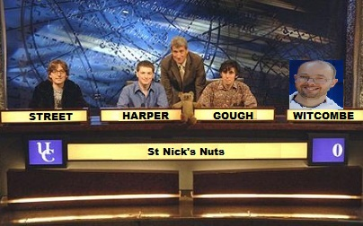
University Challenge
1962-1987 & 1994- present

Slide 18
University Challenge
In this round you can go for as many or as few of the answers as you choose, but you will get an overall score of zero on this round if you get just one incorrect answer.

Slide 19
University Challenge
Which of the chemicals shown below have a symbol of just one letter?
30 pts per correct answer; ZERO on this round for any incorrect answer.
ARGON | OXYGEN
BORON | PHOSPHORUS
BROMINE | POTASSIUM
CALCIUM | SODIUM
CARBON | SULPHUR
FLOURINE | TIN
HYDROGEN | TUNGSTEN
IODINE | URANIUM
IRON | VANADIUM
NITROGEN | YTTRIUM

Slide 20
Chemicals
I predict you will tick 12 of these and that you will not tick any of the incorrect answers.
Therefore I predict you will score 360 pts and have a total so far of 670 pts.

Slide 21
30 pts for each correct answer
ZERO on the whole round for just 1 incorrect answer
ARGON | Ar | OXYGEN | O
BORON | B | PHOSPHORUS | P
BROMINE | Br | POTASSIUM | K
CALCIUM | Ca | SODIUM | Na
CARBON | C | SULPHUR | S
FLOURINE | F | TIN | Sn
HYDROGEN | H | TUNGSTEN | W
IODINE | I | URANIUM | U
IRON | Fe | VANADIUM | V
NITROGEN | N | YTTRIUM | Y

Slide 22

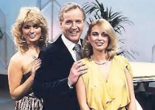
Sale of the Century
1972 - 1983

Slide 23


Sale of the Century
What was the price of a pint of beer in 1970?

Slide 24
Sale of the Century
Choose:-
Less than 9 pence
9 pence
More than 9 pence

Slide 25
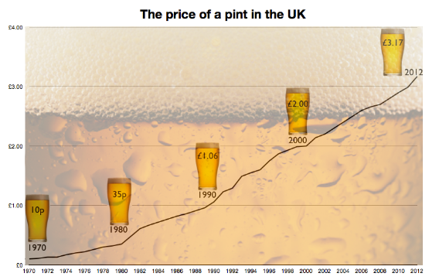
Sale of the Century
10 pence

Slide 26
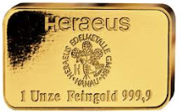
Sale of the Century
An ounce of Gold today costs £1106
What did it cost in 1930?

Slide 27
Sale of the Century
Choose:-
Less than £15
£15
More than £15

Slide 28
Sale of the Century
Gold today costs £1106 per ounce
In 1930 it was £14

Slide 29
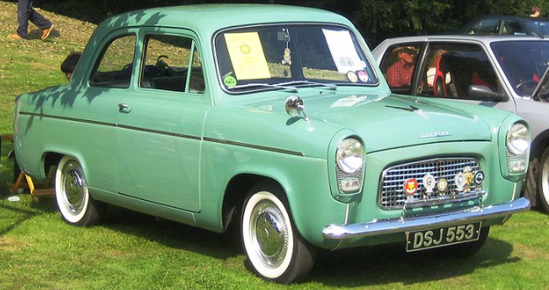
Sale of the Century
What was the cost of a Ford Popular in 1960?

Slide 30
Sale of the Century
Choose:-
Less than £500
£500
More than £500

Slide 31
Sale of the Century
£494

Slide 32

Sale of the Century
First prize in a quiz in 1900 was £5
What is the equivalent prize today?

Slide 33
Sale of the Century
Choose:-
Less than £1500
£1500
More than £1500

Slide 34
Sale of the Century
Quiz prize in 1900 was £5
The equivalent today is £1,730

Slide 35
Points
Zero out of 4 score 0
1 out of 4 scores 100 pts
2 out of 4 scores 200 pts
3 out of 4 scores 300 pts
All 4 correct scores 400 pts
(I predict 200 pts for you and a total, to date of 870 pts)

Slide 36
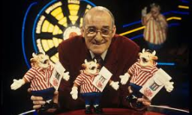
Bullseye
1981 - 1995

Slide 37
Bullseye
In this round you can tick as many numbers as you like and will score 30 pts for each correctly ticked, but if you tick just one incorrect answer your overall score on this round will be zero.

Slide 38
Bullseye
Which numbers are NOT next to 10 or 13 on a dart board?
30 pts for each correct answer
ZERO on this round if you tick a number next to 10 or 13
1 | 11
2 | 12
3 | 14
4 | 15
5 | 16
6 | 17
7 | 18
8 | 19
9 | 20

Slide 39
Bullseye
I predict you will tick 14 numbers and will avoid any incorrect answers.
Therefore I predict you will score 420 pts and have a running total of 1290 pts.

Slide 40
Bullseye
30 pts for each correct answer
ZERO if any incorrect answer is ticked
1 | √ | 11 | √
2 | √ | 12 | √
3 | √ | 14 | √
4 | x | 15 | x
5 | √ | 16 | √
6 | x | 17 | √
7 | √ | 18 | √
8 | √ | 19 | √
9 | √ | 20 | √

Slide 41
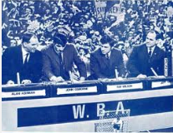
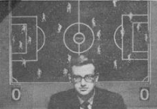
Quizball
1966 - 1972

Slide 42
Quizball
All the teams shown below were, at one time, in the Football League.
There are 8 matches for you to think about.
Which football team is currently in the higher league?
Note that if they are in the same league then it is a draw.
60 pts for each correct OR 1000 pts for ALL CORRECT
Blackburn Rovers | Southampton | Home | Draw | Away
Wolves | Doncaster Rovers | Home | Draw | Away
Hartlepool United | Port Vale | Home | Draw | Away
Grimsby Town | Burton Albion | Home | Draw | Away
Southport | Gateshead | Home | Draw | Away
Chester | FC Halifax | Home | Draw | Away
Mansfield Town | Aldershot | Home | Draw | Away
Bury | Rotherham | Home | Draw | Away

Slide 43
Quizball
I predict you will accurately forecast 6 of the ties and score 360 pts on this round.
I predict your overall running total is 1650

Slide 44
Quizball
Which football team is in the higher league?
60 pts for each correct OR 1000 pts for ALL CORRECT
Blackburn Rovers | Southampton |  |  | Away
Wolves | Doncaster Rovers | Home
Hartlepool United | Port Vale | Home
Grimsby Town | Burton Albion |  |  | Away
Southport | Gateshead |  | Draw
Chester | FC Halifax |  | Draw
Mansfield Town | Aldershot |  |  | Away
Bury | Rotherham | Home

Slide 45

Generation Game
1971-1982 & 1990 - 2002

Slide 46
Conveyor Belt
No cheating on this!
Look at each slide for 20 seconds before moving on to the next slide.

Slide 47

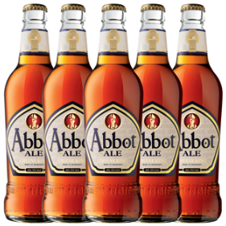
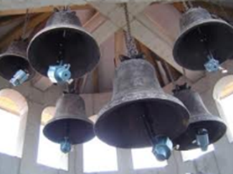
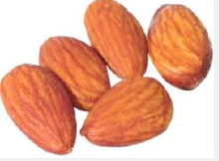
Generation Game Conveyor belt
25 points per item+ Bonus
Abbot Ales | Almonds | Bellringer | Bells

Slide 48
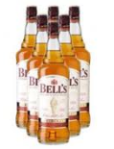
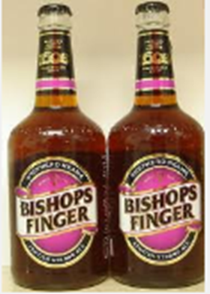
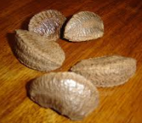
Generation Game Conveyor belt
Bells Whisky | Bishops Fingers | Brazil Nuts

Slide 49
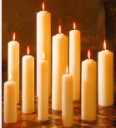
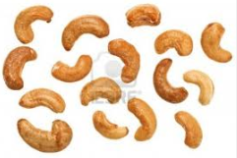
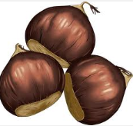
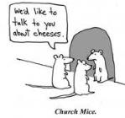

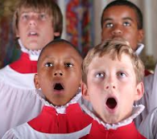
Generation Game Conveyor Belt
Candles | Cashew Nuts | Chestnuts
Choir Boys | Church Mice | Church Spires

Slide 50
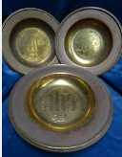
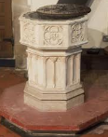
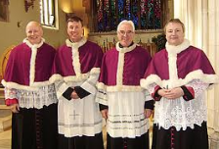
Generation Game Conveyor Belt
Collection Plates | Cuddly Canons | Font

Slide 51
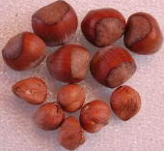
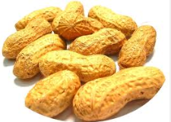
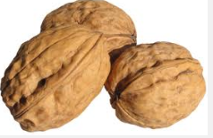
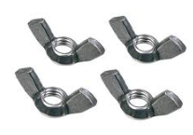
Generation Game Conveyor Belt
Hazelnuts | Monkey Nuts
Walnuts | Wingnuts

Slide 52
Generation Game
Let the thinking commence.
30 secs.

Slide 53
Keep thinking. 20 seconds to go.

Slide 54
Keep thinking. 10 seconds to go.

Slide 55
Conveyor Belt
Write down as many of the 20 items on the conveyor belt, but for a bonus you must also record how many of each of the individual items there were in each of the 20 sections.

Slide 56
Conveyor Belt
I predict, if you do this fairly, then you will remember 16 of the items and accurately record the correct number of 10 of those 16 items.
Hence, I predict 16 x 25 pts + 10 x 25 pts = 650 pts, and a running total of 2300 pts.

Slide 57
Generation Game Conveyor Belt
25 pts each item (50 pts if correct number)
Abbot Ales | 5 | Choir Boys | 4
Almonds | 5 | Church Mice | 3
Bellringer | 1 | Church Spires | 3
Bells | 6 | Collection Plates | 3
Bells Whiskey | 6 | Cuddly Canons | 4
Bishops Fingers | 2 | Font | 1
Brazil Nuts | 5 | Hazelnuts | 12
Candles | 10 | Monkey Nuts | 11
Cashew Nuts | 16 | Walnuts | 3
Chestnuts | 3 | Wingnuts | 4

Slide 58
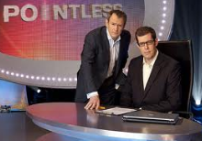
Pointless
24th August 2009 - present

Slide 59
Word Round
Think of a word in the Oxford English Dictionary ending in
UNE
The longer, more obscure your word the more points you will score.
Points will be awarded from 1 to 500 for the word you choose.

Slide 60
Pointless
What is your word?
I predict you will score 300 pts and have an overall total 2600 pts.

Slide 61
The Junior Board
AUNE | 50 | IMMUNE | 150 | DEJEUNE | 250
DUNE | 10 | IMPUNE | 200 | DISTUNE | 250
JUNE | 10 | INTUNE | 150 | FORTUNE | 220
LUNE | 10 | JEJUNE | 200 | MISTUNE | 220
RUNE | 50 | LACUNE | 200 | NEPTUNE | 220
TUNE | 10 | LAGUNE | 200 | REPRUNE | 250
PAUNE | 100 | PETUNE | 200 | TRIBUNE | 220
PRUNE | 50 | TRIUNE | 150 | DEMILUNE | 300
SOUNE | 100 | UNTUNE | 150 | PERILUNE | 300
ATTUNE | 100 | APOLUNE | 250 | PICAYUNE | 300
COHUNE | 100 | BETHUNE | 250 | SEMILUNE | 300
ENTUNE | 100 | COMMUNE | 220 | VIRAMUNE | 300

Slide 62
And the big boys board!!!
BEFORTUNE | 350 | PLENILUNE | 400
EXCOMMUNE | 350 | AUTOIMMUNE | 500
IMPORTUNE | 350 | MALACATUNE | 500
INFORTUNE | 350 | MISFORTUNE | 400
NONIMMUNE | 350 | INOPPORTUNE | 450
NYCTIBUNE | 400 | REIMPORTUNE | 500
OPPORTUNE | 350

Slide 63
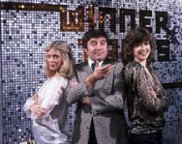
Winner Takes All
1975 – 1988

Slide 64
Winner Takes All
In this round you will be asked a question and have to choose from 5 answers. You can gamble up to half your points on your answer, but will lose those points if you choose the wrong answer.

Slide 65
Who was the first person to win the Sports Personality of the Year in 1954?
A | Jim Laker (Cricket)
B | David Broome (Show Jumping)
C | Chris Chataway (Athletics)
D | John Surtees (Motor Racing)
E | Roger Bannister (Athletics)

Slide 66
Winner Takes All
I predict you will gamble 1000 pts and will know the right answer to take your total to 3600 pts.
How much are you gambling and what is your answer?

Slide 67
Who was the first person to win the Sports Personality of the Year in 1954?
A | Jim Laker (Cricket)
B | David Broome (Show Jumping)
C | Chris Chataway (Athletics)
D | John Surtees (Motor Racing)
E | Roger Bannister (Athletics)

Slide 68
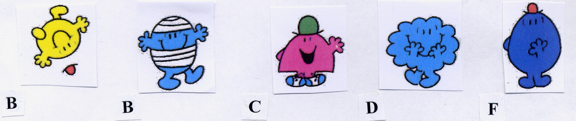
Mr Happy contains 5 letters other than Mr.
What is the total number of letters, not counting Mr, in each of the following?
A | 35
B | 36
C | 37
D | 38
E | None of these

Slide 69
Winner Takes All
I predict you will gamble 600 pts and will not know the right answer to take your total to 3000 pts.
How much are you gambling and what is your answer?

Slide 70
What is the total number of letters, not counting Mr, in each of the following?
Bounce
Bump
Chatterbox
Daydream
Forgetful
A | 35
B | 36
C | 37
D | 38
E | None of these

Slide 71
How many of the following are spelt correctly?
Aquire
Accommodate
Amateur
Arguement
Changable
A | 5
B | 4
C | 3
D | 2
E | 1

Slide 72
Winner Takes All
I predict you will gamble 1500 pts and will know the right answer to take your total to 4500 pts.
How much are you gambling and what is your answer?

Slide 73
How many of the following are spelt correctly?
Aquire Acquire
Accommodate
Amateur
Arguement Argument
Changable Changeable
A | 5
B | 4
C | 3
D | 2
E | 1

Slide 74




How many flags have their correct countries below them?
SWEDEN
ICELAND
DENMARK
NORWAY
A | 4
B | 3
C | 2
D | 1
E | 0

Slide 75
Winner Takes All
I predict you will gamble 2250 pts and will know the right answer to take your total to 6750 pts.
How much are you gambling and what is your answer?

Slide 76
How many flags are correct?
SWEDEN
NORWAY
DENMARK
ICELAND
A | 4
B | 3
C | 2
D | 1
E | 0

Slide 77
In 2004 the BBC held a poll of their Top 5 BBC Sitcoms of all time. Shown below are 5 sitcoms, 4 of which were in the Top 5.Which was not in the top 5 list?
A | Porridge
B | Vicar of Dibley
C | Fawlty Towers
D | Dad’s Army
E | Only Fools and Horses

Slide 78
Winner Takes All
The final question.
I predict you will gamble 3250 pts and will know the right answer to take your total to 10,000 pts.
How much are you gambling and what is your answer?

Slide 79
Top 5 BBC Sitcoms:- which was not in the list?
A | Porridge Black Adder
B | Vicar of Dibley
C | Fawlty Towers
D | Dad’s Army
E | Only Fools and Horses

