Slide 1

Welcome to the St Nicholas Quiz
Friday 19th April 2013

Slide 2
Your Challenge
To achieve at least 10,000 points over the 8 rounds.

Slide 3
Celebrating TV Quiz Shows
A Question of Sport
University Challenge
Sale of the Century
Double your Money
Take Your Pick
Generation Game
Pointless
Winner Takes All

Slide 4

A Question of Sport
2nd December 1968 – present day

Slide 5
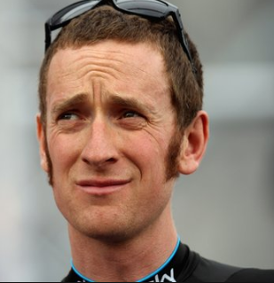
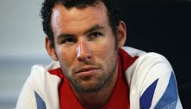
Question of Sport
Sports Personalities of the Year
10 pts per competitor (Bonus 10 pts for event)
1 (2012) | 2 (2011)

Slide 6
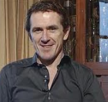
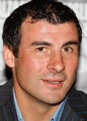
Question of Sport
Sports Personalities of the Year
10 pts per competitor (Bonus 10 pts for event)
3 (2010) | 4 (2007)

Slide 7
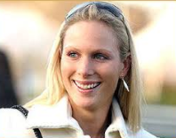
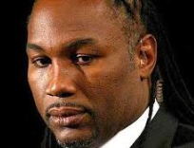
Question of Sport
Sports Personalities of the Year
10 pts per competitor (Bonus 10 pts for event)
5 (2006) | 6 (1999)

Slide 8
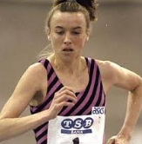

Question of Sport
Sports Personalities of the Year
10 pts per competitor (Bonus 10 pts for event)
7 (1991) | 8 (1980)

Slide 9
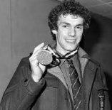
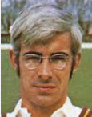
Question of Sport
Sports Personalities of the Year
10 pts per competitor (Bonus 10 pts for event)
9 (1976) | 10 (1975)

Slide 10
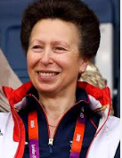
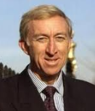
Question of Sport
Sports Personalities of the Year
10 pts per competitor (Bonus 10 pts for event)
11 (1971) | 12 (1968)

Slide 11
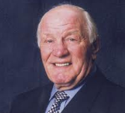
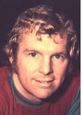
Question of Sport
Sports Personalities of the Year
10 pts per competitor (Bonus 10 pts for event)
13 (1967) | 14 (1966)

Slide 12
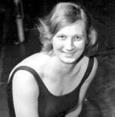
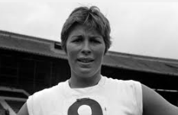
Question of Sport
Sports Personalities of the Year
10 pts per competitor (Bonus 10 pts for event)
15 (1964) | 16 (1962)

Slide 13
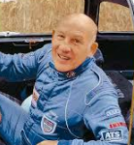
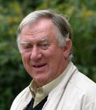
Question of Sport
Sports Personalities of the Year
10 pts per competitor (Bonus 10 pts for event)
17 (1961) | 18 (1960)

Slide 14
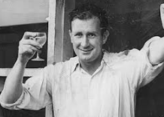
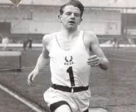
Question of Sport
Sports Personalities of the Year
10 pts per competitor (Bonus 10 pts for event)
19 (1956) | 20 (1954)

Slide 15
10 pts per competitor + 10 pts per event
1 | Bradley Wiggins | Cycling | 11 | Princess Anne | Eventing
2 | Mark Cavendish | Cycling | 12 | David Hemery | Athletics
3 | Tony McCoy | Horse racing | 13 | Henry Cooper | Boxing
4 | Joe Calzaghe | Boxing | 14 | Bobby Moore | Football
5 | Zara Phillips | Eventing | 15 | Mary Rand | Athletics
6 | Lennox Lewis | Boxing | 16 | Anita Lonsbrough | Swimming
7 | Liz McColgan | Athletics | 17 | Stirling Moss | Motor racing
8 | Robin Cousins | Figure Skating | 18 | David Broome | Show Jumping
9 | John Curry | Figure Skating | 19 | Jim Laker | Cricket
10 | David Steele | Cricket | 20 | Chris Chataway | Athletics

Slide 16
Assessment
You should, by now, have gained at least 260 points.
How are you doing?

Slide 17
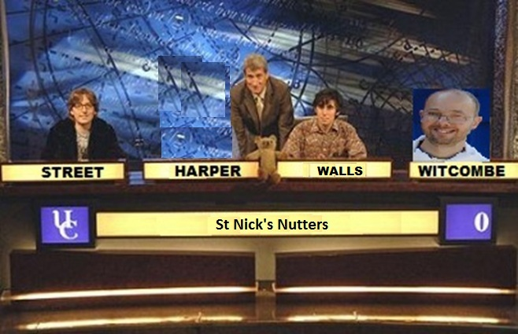
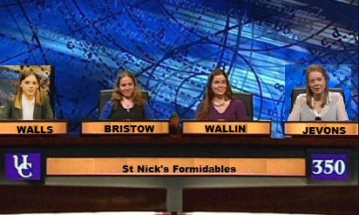
University Challenge
1962-1987 & 1994- present

Slide 18
University Challenge
Which of these countries are entirely in the Northern Hemisphere?
30 pts per correct answer; TOTAL SCORE OF ZERO on this round for even one incorrect answer.
BRAZIL | JAMAICA
CANADA | JAPAN
CHILE | KENYA
CHINA | MALTA
COLUMBIA | MEXICO
CYPRUS | SOMALIA
DEMOCRATIC REPUBLIC OF CONGO | SPAIN
GREECE | TUNISIA
ICELAND | UGANDA
ITALY | USA

Slide 19
University Challenge
Which of these countries are entirely in the Northern Hemisphere?
30 pts per correct answer; TOTAL SCORE OF ZERO on this round for even one incorrect RED answer.
BRAZIL | JAMAICA
CANADA | JAPAN
CHILE | KENYA
CHINA | MALTA
COLUMBIA | MEXICO
CYPRUS | SOMALIA
DEMOCRATIC REPUBLIC OF CONGO | SPAIN
GREECE | TUNISIA
ICELAND | UGANDA
ITALY | USA

Slide 20
Assessment
I think you will have avoided all of the RED ones, but will have been cautious in nominating just 10 correct answers. This earns 300 points.
You are probably on 560 points.

Slide 21

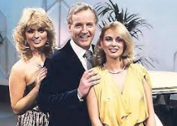
Sale of the Century
1972 - 1983

Slide 22
Sale of the Century
All 5 correct earns 500 pts
Just 4 correct earns 400 pts
Exactly 3 correct earns 300 pts
Just 2 correct earns 200 pts
Only 1 correct earns 100 pts

Slide 23
Argos
All items are taken from the current Argos catalogue.
They are items that are used from daybreak to nightfall.
You are trying to predict their prices and, in each case, should choose from 3 options.

Slide 24
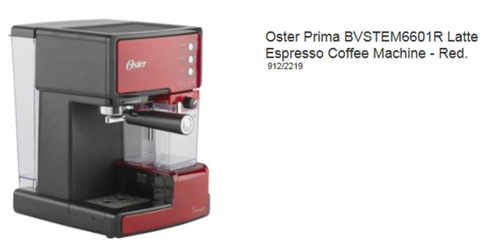
Sale of the Century
Only the 5 teams closest to the actual price survive.
In the morning wake up to your refreshing cup of coffee.

Slide 25
Choices
Less than £140
£140 to £165
More than £165

Slide 26
Expresso Coffee Maker
£169

Slide 27
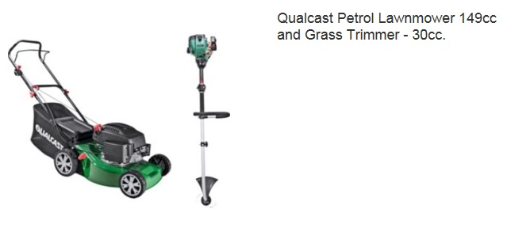
Sale of the Century
Cut the lawn in the morning.

Slide 28
Choices
Less than £200
£200 to £249
More than £249

Slide 29
Lawnmower
£199

Slide 30
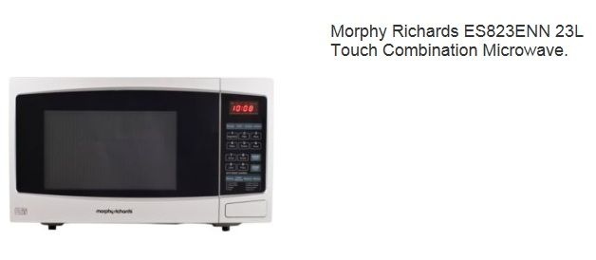
Sale of the Century
Quick lunch in the microwave

Slide 31
Choices
Less than £70
£70 to £85
More than £85

Slide 32
Microwave
£74

Slide 33
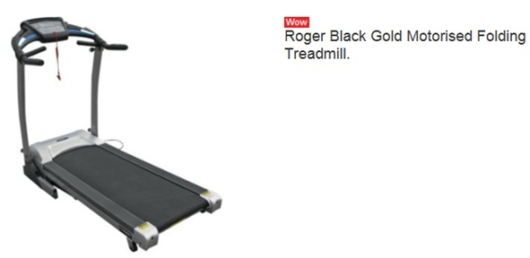
Sale of the Century
Battle to be in top 2
Afternoon fitness regime

Slide 34
Choices
Less than £350
£350 to £399
More than £399

Slide 35
Treadmill
£349

Slide 36
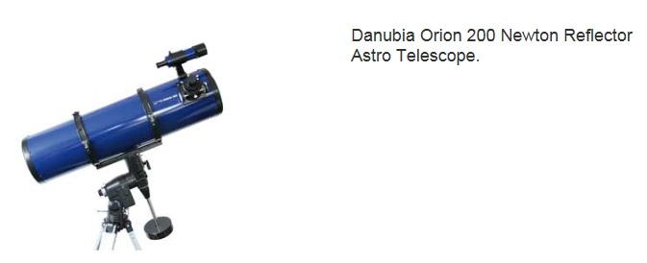
Sale of the Century
The Grand Final
Before Bed:See the Stars (not Stairs)

Slide 37
Choices
Less than £450
£450 to £600
More than £600

Slide 38
Telescope
£636

Slide 39
Sale of the Century
All 5 correct earns 500 pts
Just 4 correct earns 400 pts
Exactly 3 correct earns 300 pts
Just 2 correct earns 200 pts
Only 1 correct earns 100 pts
Score zero if none correct

Slide 40
Assessment
You probably got 3 correct earning 300 points.
You probably have 860 points by now.

Slide 41
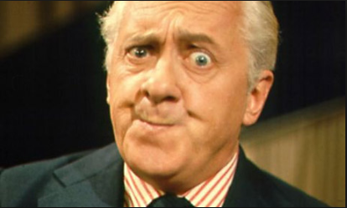
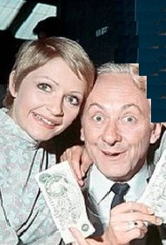
Double Your Money
1955 - 1968
Hughie Green
Monica Rose & Hughie Green

Slide 42
Win from 50 to 6,400 pts
All questions relate to the real names or character names of famous TV Stars in popular programmes.
Answer 8 questions correctly to win 6,400
You can quit whenever you like to claim your points before the next question is asked.

Slide 43
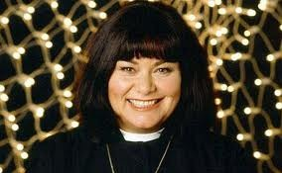
For 50 points
What is Dawn French’s name in The Vicar of Dibley?

Slide 44
Rev Geraldine Granger
Double or Quits?

Slide 45
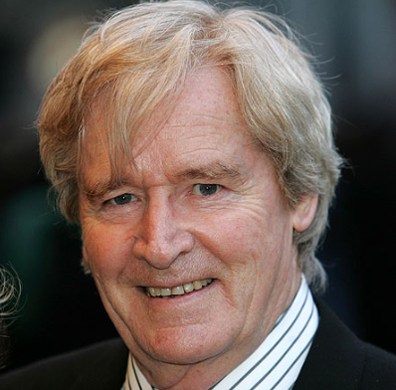
For 100 points
What is Ken Barlow’s real name?

Slide 46
William (Bill) Roache
Double or Quits?

Slide 47
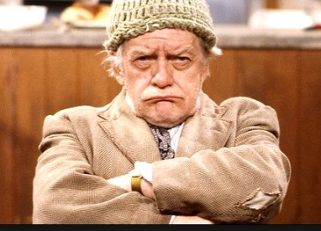
For 200 points
Who played Compo in Last of the Summer Wine?

Slide 48
Bill Owen
Double or Quits?

Slide 49
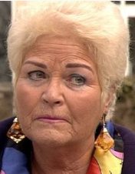
For 400 points
Who plays Pat Butcher (nee Evans, Harris, Beale, Wicks) in Eastenders?

Slide 50
Pam St Clement
Double or Quits?

Slide 51
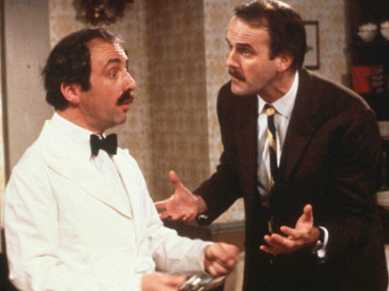
For 800 points
Who played Manuel in Fawlty Towers?

Slide 52
Andrew Sachs
Double or Quits?

Slide 53
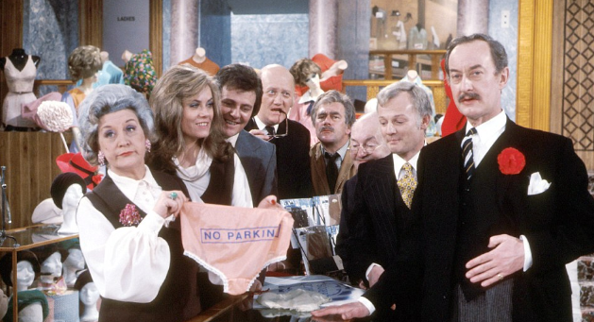
For 1,600 points
Who played Captain Peacock in ‘Are you being served?’

Slide 54
Frank Thornton
Double or Quits?

Slide 55
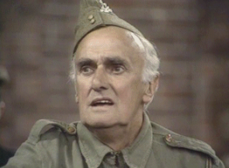
For 3,200 points
Who played Private James Frazer in Dad’s Army?

Slide 56
John Laurie
Double or Quits?

Slide 57
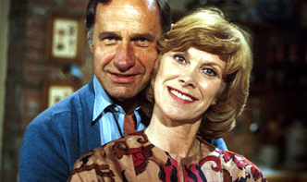
For 6,400 points
Who was the character played by Wendy Craig in Butterflies BBC 1 from 1975 – 1983?

Slide 58
Ria Parkinson
Did you hit the jackpot?
You probably got as far as Compo and quit while still ahead. Probably got 200 points
Likely current total 1060 points

Slide 59
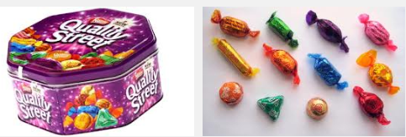
Half way through the show
Why not reward yourself with chocolate?

Slide 60
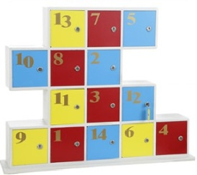
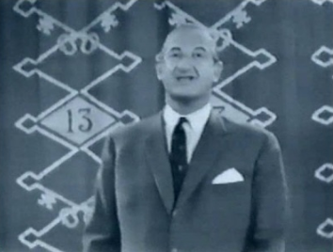
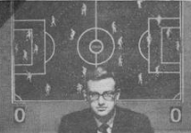
Take Your Pick
1955 - 1968
Michael Miles

Slide 61
Points available
0 100 200 300
400 500 600 800
1000 1200 1500
1800 2000
A share of Mystery box 13

Slide 62
Playing the game
Choose a box number from 1 to 12 or number 14.
Would you like to exchange your box for a share of Box 13?
Would you like to exchange your box for 600 points and not have to answer a question?
If you have answered NO to both questions then go to your box number and answer the question.

Slide 63
Box 1
Name a US state beginning with A

Slide 64
States starting A
Alabama
Alaska
Arizona
Arkansas
A correct answer earns you 200 points

Slide 65
Box 2
Name a US state beginning with C

Slide 66
States beginning with C
California
Colorado
Connecticut
A correct answer earns you 1200 points

Slide 67
Box 3
Name a US state beginning with D, F, G or H.

Slide 68
Box 3
States starting with D, F, G or H.
Delaware
Florida
Georgia
Hawaii
A correct answer earns you 100 points

Slide 69
Box 4
Name a US state starting with I

Slide 70
Box 4
States starting with I
Idaho
Illinois
Indiana
Iowa
A correct answer earns you 1500 points

Slide 71
Box 5
Name a US state starting with K or L.

Slide 72
Box 5
States starting with K or L
Kansas
Kentucky
Louisiana
A correct answer earns you 300 points

Slide 73
Box 6
Name a US state starting with M.

Slide 74
Box 6
US States starting with M
Maine Maryland
Massachusetts Michigan
Minnesota Mississippi
Missouri Montana
A correct answer earns you 600 points

Slide 75
Box 7
Name a US state starting with N

Slide 76
Box 7
States starting with N
Nebraska Nevada
New Hampshire New Jersey
New Mexico New York
North Carolina North Dakota
A correct answer earns you 1000 points

Slide 77
Box 8
Name a US state starting with O

Slide 78
Box 8
States starting with O
Ohio
Oklahoma
Oregon
This box was empty and earned Zero points

Slide 79
Box 9
Name a US state starting with P, R or U

Slide 80
Box 9
States starting with P, R or U
Pennsylvania
Rhode Island
Utah
A correct answer earned you 2000 points

Slide 81
Box 10
Name a US state starting with S

Slide 82
Box 10
States starting with S
South Carolina
South Dakota
A correct answer earned you 400 points

Slide 83
Box 11
Name a US state starting with T

Slide 84
Box 11
States starting with T
Tennessee
Texas
A correct answer earned you 800 points

Slide 85
Box 12
Name a US state starting with V

Slide 86
Box 12
States starting with V
Vermont
Virginia
A correct answer earned you 500 points

Slide 87
Box 14
Name a US state starting with W

Slide 88
Box 14
States starting with W
Washington
West Virginia
Wisconsin
Wyoming
A correct answer earned you 1800 points

Slide 89
Box 13
How many are sharing the points in Box 13?

Slide 90
Box 13
This mystery box contains 3600 points.
You shared it with 3 others, so earned 900 points

Slide 91
Assessment
I think you would have got 600 points, giving you a likely running total of 1660.
Are you beating this?

Slide 92
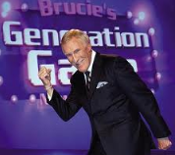
Generation Game
1971-1982 & 1990 - 2002

Slide 93
Rules
Look at each slide for 30 seconds, remembering the items, the number of each item and the colour the word is written in.
Don’t make notes or cheat!!!

Slide 94

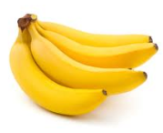
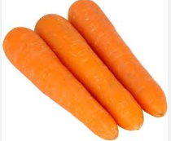
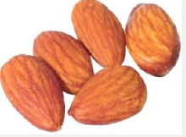
Generation Game Conveyor belt
25 points per item+ Bonuses
Apples | Almonds | Bananas | Carrots

Slide 95
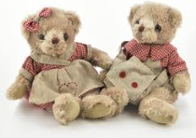
Generation Game Conveyor Belt
Cuddly Toys

Slide 96
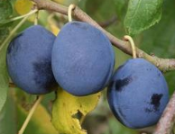
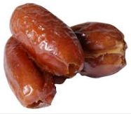
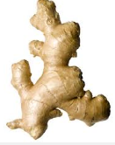
Generation Game Conveyor belt
Damsons | Dates | Ginger

Slide 97
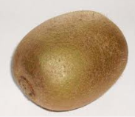





Generation Game Conveyor Belt
Kiwi Fruit | Lemons | Limes
Nectarines | Olives | Peaches

Slide 98


Generation Game Conveyor Belt
Quince | Raspberries

Slide 99




Generation Game Conveyor Belt
Strawberries | Tangerines
Ugli | Walnuts

Slide 100
Generation Game
Let the thinking commence

Slide 101
Conveyor belt
You have 2 minutes to make a note of as many items as you can, recording the number of each item and the colour in which the word was written.

Slide 102
Generation Game Conveyor Belt
25 pts each item (25 pt bonus for correct number and 25pt bonus for correct colour)
Apples | 3 | Red | Limes | 2 | Yellow
Almonds | 5 | Green | Nectarines | 4 | Red
Bananas | 4 | Orange | Olives | 2 | Yellow
Carrots | 3 | Blue | Peaches | 2 | Blue
Cuddly Toys | 2 | Orange | Quince | 1 | Black
Damsons | 3 | Green | Raspberries | 3 | Green
Dates | 3 | Red | Strawberries | 3 | Green
Ginger | 1 | Blue | Tangerines | 3 | Yellow
Kiki | 1 | Blue | Ugli | 2 | Red
Lemons | 3 | Red | Walnuts | 3 | Blue

Slide 103
Assessment
You probably remembered 16 items, the correct number of 12 of these, and the correct colour of just 8 of these.
You probably scored 36 x 25 = 900 points.
Your likely current total is 2560 points.
Are you beating this?

Slide 104

Pointless
24th August 2009 - present

Slide 105
Word Round
Think of a word in the Oxford English Dictionary ending in
UME
The longer, more obscure your word the more points you will score.
Points from 1 to 500 are available.

Slide 106
Pointless
What is your word?

Slide 107
The Junior Board
ABSUME | 50 | EFFUME | 150 | PERFUME | 50
APAUME | 100 | EXHUME | 50 | PLUME | 20
APPAUME | 100 | FLUME | 150 | PRESUME | 50
ASSUME | 10 | FUME | 20 | PUME | 100
BAUME | 200 | GLUME | 100 | REAUME | 200
BITUME | 100 | GRUME | 200 | RELUME | 250
BRUME | 100 | HEAUME | 300 | RESUME | 50
CONSUME | 10 | HUME | 150 | REUME | 300
COSTUME | 20 | ILLUME | 50 | SPUME | 300
DEPLUME | 100 | INHUME | 100 | SUBSUME | 100
DESPUME | 200 | INSUME | 150 | UNPLUME | 300
DESUME | 100 | LEGUME | 20 | VOLUME | 20

Slide 108
And the big boys board!!!
APOSTUME | 350 | DISINHUME | 400
DISPLUME | 350 | FILOPLUME | 500
ENVOLUME | 350 | INTROSUME | 500
REASSUME | 350 | SEMIPLUME | 400
REILLUME | 350 | CORNIPLUME | 450
TRANSUME | 400 | IMPOSTHUME | 500
NEUME | 500

Slide 109
Assessment
You probably scored no better than 100 on this.
Your likely current total is 2660 points.
Are you beating this?

Slide 110

Winner Takes All
1975 – 1988

Slide 111
Rules
You will be asked a question and given 5 answers to choose from.
You can gamble up to half of your current total, but if you get it wrong you lose those points.

Slide 112
How many different British Prime Ministers have there been during the reign of Queen Elizabeth II ?
A | 10
B | 11
C | 12
D | 13
E | 14

Slide 113
How many different British Prime Ministers have there been during the reign of Queen Elizabeth II ?
A | 10
B | 11
C | 12
D | 13
E | 14
Churchill, Eden, Macmillan, Douglas-Home, Wilson, Heath, Callaghan
Thatcher, Major, Blair, Brown, Cameron

Slide 114
Assessment
You probably gambled 660 and got it wrong!
Likely current total 2000 points.
Are you beating this?

Slide 115
What is the TOTAL number of letters in these Shakespeare plays beginning with T?
TA……. …. ….. ……..EW
TI…….. …………….US
TR………… …. ……………DA
TW…………. ….HT
TW.. …………………….. … …….NA
A | 78
B | 79
C | 80
D | 81
E | None of these

Slide 116
What is the TOTAL number of letters in these Shakespeare plays beginning with T?
TAMING OF THE SHREW
TITUS ANDRONICUS
TROILUS AND CRESSIDA
TWELFTH NIGHT
TWO GENTLEMEN OF VERONA
A | 78
B | 79
C | 80
D | 81
E | None of these

Slide 117
Assessment
You probably gambled 1000 points and were correct.
Your likely current total is 3000 points.
Are you beating this?

Slide 118
How many of the following are spelt correctly?
Attrocity
Drunkenness
Dumbbell
Innoculate
Supercede
A | 5
B | 4
C | 3
D | 2
E | 1

Slide 119
How many of the following are spelt correctly?
Attrocity (Atrocity)
Drunkenness
Dumbbell
Innoculate (Inoculate)
Supercede (Supersede)
A | 5
B | 4
C | 3
D | 2
E | 1

Slide 120
Assessment
You probably gambled 1500 points and were correct.
Likely current total 4500 points.
Are you beating this?

Slide 121
How many of the following countries use the Euro as their official currency?
Andorra
Finland
Malta
Slovakia
Switzerland
A | 1
B | 2
C | 3
D | 4
E | 5

Slide 122
How many of the following countries use the Euro as their official currency?
Andorra
Finland
Malta
Slovakia
Switzerland (Franc)
A | 1
B | 2
C | 3
D | 4
E | 5

Slide 123
Assessment
You probably gambled 2250 points and were correct.
Your likely current total is 6750.
Are you beating this?

Slide 124

In which county is the Cathedral shown below?
A | Kent
B | Wiltshire
C | Lincolnshire
D | North Yorkshire
E | None of these

Slide 125
In which county is the Cathedral shown below?
A | Kent
B | Wiltshire
C | Lincolnshire
D | North Yorkshire
E | None of these (Cambridgeshire)

Slide 126
Assessment
You probably gambled 1250 points and was correct.
Your likely current total is 8000 points.
Are you beating this?

Slide 127
What is the total number of players in one team, on the field of play at any time, in the 5 sports listed below?
POLO, BASKETBALL, ICE HOCKEY, VOLLEYBALL, RUGBY LEAGUE
A | 34
B | 35
C | 36
D | 37
E | None of these

Slide 128
What is the total number of players in one team, on the field of play at any time, in the 5 sports listed below?
POLO (4), BASKETBALL (5), ICE HOCKEY (6), VOLLEYBALL (6), RUGBY LEAGUE (13)
A | 34
B | 35
C | 36
D | 37
E | None of these

Slide 129
You probably gambled 2000 points and were correct.
You have probably made it to 10,000 points.
Have you though?
That’s all folks

