Slide 1
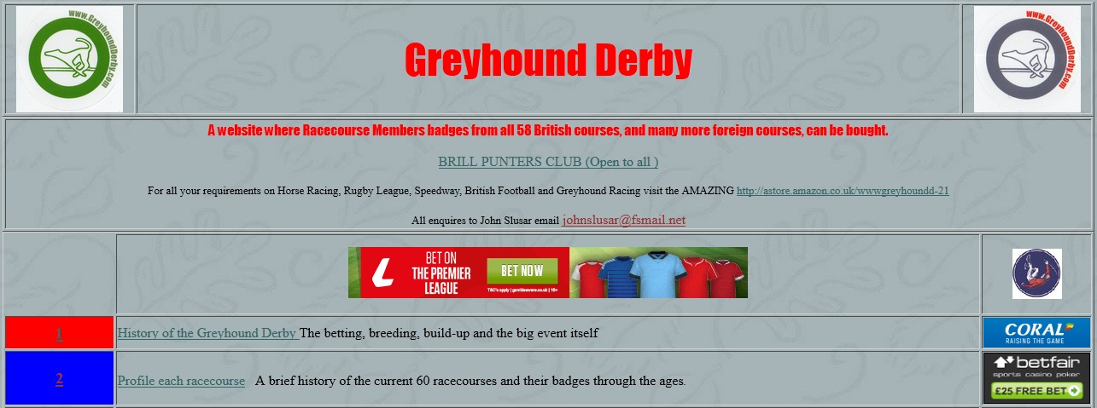
Welcome to the Greyhoundderby’s Quiz 6

Slide 2
Rules of the Quiz
In Round 1, the Question of Sport round, you will be shown 20 sporting personalities. Identify them and receive 25 pts for each. Identify their sport for a bonus 25 pts for each.
At the end of Round 1 you will have anything between 0 and 1000 pts. In the Winner Takes all round there are 20 questions. You can stake up to half the points you own. If correct you win those points, but if wrong you lose them.

Slide 3
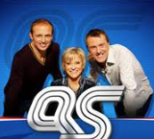
A Question of Sport
2nd December 1968 – present day

Slide 4
Target
You have to identify the sports personality for 25 points, and a bonus of 25 points for naming their sport.
A total of 1000 pts is available.
Your target is 700 points

Slide 5
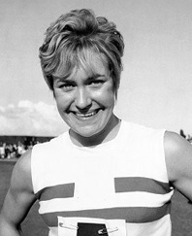
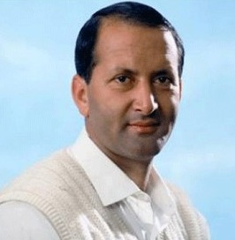
Question of Sport
25 pts per competitor (Bonus 25 pts for their sport)
Number 1 | Number 2

Slide 6
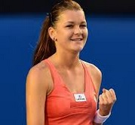
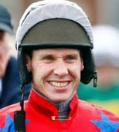
Question of Sport
25 pts per competitor (Bonus 25 pts for sport)
Number 3 | Number 4

Slide 7
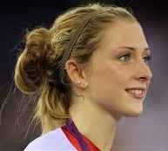
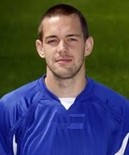
Question of Sport
25 pts per competitor (Bonus 25 pts for event)
Number 5 | Number 6

Slide 8
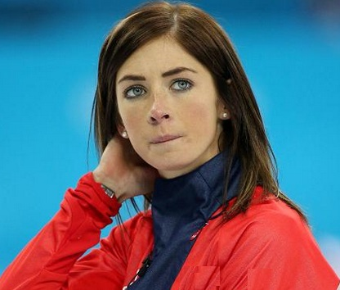
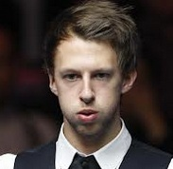
Question of Sport
25 pts per competitor (Bonus 25 pts for sport)
Number 7 | Number 8

Slide 9
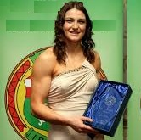
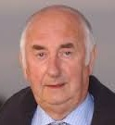
Question of Sport
25 pts per competitor (Bonus 25 pts for sport)
Number 9 | Number 10

Slide 10
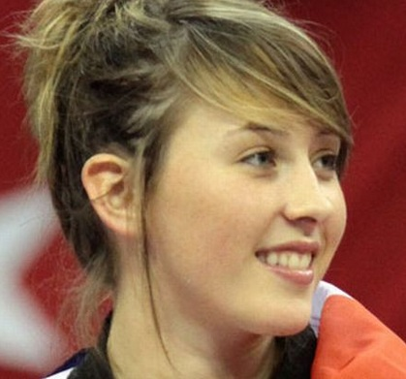
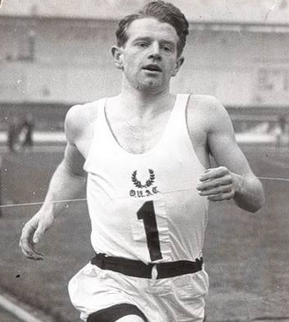
Question of Sport
25 pts per competitor (Bonus 25 pts for sport)
Number 11 | Number 12

Slide 11
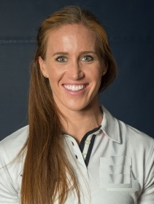
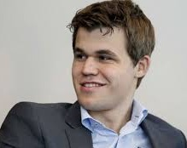
Question of Sport
25 pts per competitor (Bonus 25 pts for sport)
Number 13 | Number 14

Slide 12
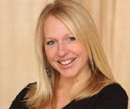
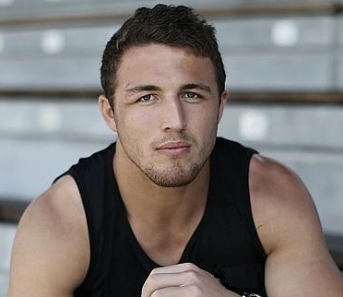
Question of Sport
25 pts per competitor (Bonus 25 pts for event)
Number 15 | Number 16

Slide 13
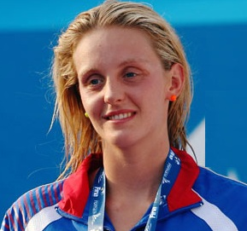
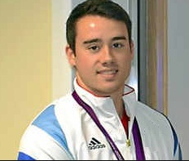
Question of Sport
25 pts per competitor (Bonus 25 pts for sport)
Number 17 | Number 18

Slide 14
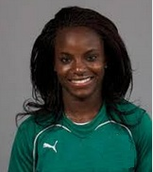
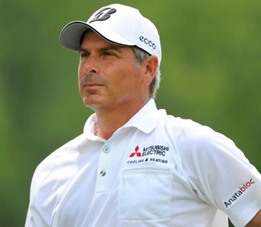
Question of Sport
25 pts per competitor (Bonus 25 pts for sport)
Number 19 | Number 20

Slide 15
25 pts per competitor + 25 pts per sport
Qu | Answer | Sport | Qu | Answer | Sport
1 |  |  | 11
2 |  |  | 12
3 |  |  | 13
4 |  |  | 14
5 |  |  | 15
6 |  |  | 16
7 |  |  | 17
8 |  |  | 18
9 |  |  | 19
10 |  |  | 20

Slide 16
Answers
No. | Person | Sport | No. | Person | Sport
1 | Lillian Board | Athletics | 11 | Jade Jones | Taekwondo
2 | Basil D’Oliveira | Cricket | 12 | Chris Chataway | Athletics
3 | Agnieszka Radwanska | Tennis | 13 | Helen Glover | Rowing
4 | Richard Johnson | Racing | 14 | Magnus Carlsen | Chess
5 | Laura Trott | Cycling | 15 | Gail Emms | Badminton
6 | Matty Fryatt | Football | 16 | Sam Burgess | Rugby
7 | Eve Muirhead | Curling | 17 | Fran Halsall | Swimming
8 | Judd Trump | Snooker | 18 | Kristian Thomas | Gymnastics
9 | Katy Taylor | Boxing | 19 | Eniola Aluko | Football
10 | Charlie Lister | Greyhounds | 20 | Fred Couples | Golf

Slide 17
Target
The target was 700 points.
How did you do?
Did you meet the target, or even surpass it?

Slide 18
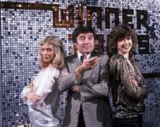
Winner Takes All
1975 – 1988

Slide 19
Winner Takes All Rules
In this round there are 20 questions. For each question you can stake up to half the points you own at that point.
If you are correct you profit by those points, but if you choose wrongly you lose those points.
Your target at the end of this quiz is to achieve 20,000 points.

Slide 20
Question 1
Which of the football teams shown below has never won the F A Cup?
A | Leicester City
B | Bury
C | Barnsley
D | Notts County
E | Bradford City

Slide 21
Question 1
Which of the football teams shown below has never won the F A Cup?
A | Leicester City
B | Bury
C | Barnsley
D | Notts County
E | Bradford City
Bury 1900, 1903 Barnsley 1912 Notts County 1894 Bradford City 1911

Slide 22
Question 2
What is the TOTAL number of letters in these Shakespeare plays beginning with T?
TA……. …. ….. ……..EW
TI…….. …………….US
TR………… …. ……………DA
TW…………. ….HT
TW.. …………………….. … …….NA
A | 80
B | 81
C | 82
D | 83
E | 84

Slide 23
Question 2
What is the TOTAL number of letters in these Shakespeare plays beginning with T?
TAMING OF THE SHREW (16)
TITUS ANDRONICUS (15)
TROILUS AND CRESSIDA (18)
TWELFTH NIGHT (12)
TWO GENTLEMEN OF VERONA (20)
A | 80
B | 81
C | 82
D | 83
E | 84

Slide 24
Question 3
How many of the following are spelt correctly?
Attrocity
Drunkenness
Dumbbell
Innoculate
Supercede
A | 5
B | 4
C | 3
D | 2
E | 1

Slide 25
Question 3
How many of the following are spelt correctly?
Attrocity (Atrocity)
Drunkenness
Dumbbell
Innoculate (Inoculate)
Supercede (Supersede)
A | 5
B | 4
C | 3
D | 2
E | 1

Slide 26
Question 4
How many of the following countries use the Euro as their official currency?
Andorra
Finland
Malta
Slovakia
Switzerland
A | 1
B | 2
C | 3
D | 4
E | 5

Slide 27
Question 4
How many of the following countries use the Euro as their official currency?
Andorra
Finland
Malta
Slovakia
Switzerland
A | 1
B | 2
C | 3
D | 4
E | 5

Slide 28
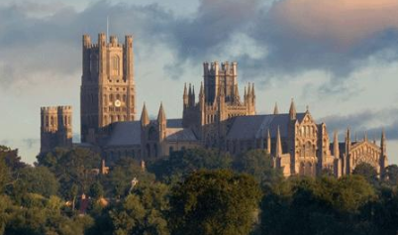
Question 5
In which county is the Cathedral shown below?
A | Kent
B | Wiltshire
C | Lincolnshire
D | North Yorkshire
E | None of these

Slide 29
Question 5
In which county is the Cathedral shown below?
A | Kent
B | Wiltshire
C | Lincolnshire
D | North Yorkshire
E | None of these Ely Cathedral in Cambridgeshire

Slide 30
Question 6
In the FA Cup, since its inception, which team has scored the most goals in a single match?
A | Arbroath
B | Preston North End
C | Nottingham Forest
D | Royal Engineers
E | None of these

Slide 31
Question 6
In the FA Cup, since its inception, which team has scored the most goals in a single match?
A | Arbroath
B | Preston North End Preston beat Hyde 26-0 on 15th October 1887
C | Nottingham Forest
D | Royal Engineers
E | None of these

Slide 32
Question 7
How many of the following countries are in the Top 10 largest countries in the world by land mass?
Algeria
Argentina
Australia
India
Kazakhstan
A | 5
B | 4
C | 3
D | 2
E | 1

Slide 33
Question 7
How many of the following countries are in the Top 10 largest countries in the world by land mass?
Algeria 10th
Argentina 8th
Australia 6th
India 7th
Kazakhstan 9th
Top 5 area Russia, Canada, China, USA, Brazil
A | 5
B | 4
C | 3
D | 2
E | 1

Slide 34
Question 8
The 3 Thoroughbred stallions from which all racehorses originate were the Byerley Turk, the Darley Arabian and the Godolphin Arabian. Where is the Godolphin Arabian buried?
A | Newmarket
B | Black Hambleton
C | Dubai
D | Wandelbury
E | Ascot racecourse

Slide 35
Question 8
The 3 Thoroughbred stallions from which all racehorses originate were the Byerley Turk, the Darley Arabian and the Godolphin Arabian. Where is the Godolphin Arabian buried?
A | Newmarket
B | Black Hambleton
C | Dubai
D | Wandelbury
E | Ascot racecourse

Slide 36
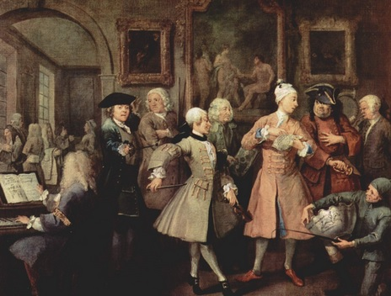
Question 9
Who painted the picture shown below?
A | William Hogarth
B | Peter Lely
C | Joshua Reynolds
D | James Seymour
E | John Vanderbank

Slide 37
Question 9
Who painted the picture shown below?
A | William Hogarth
B | Peter Lely
C | Joshua Reynolds
D | James Seymour
E | John Vanderbank

Slide 38
Question 10
Which of his 6 wives is Henry Viii buried next to?
A | Catherine of Aragon
B | Anne Boleyn
C | Jane Seymour
D | Catherine Howard
E | Catherine Parr

Slide 39
Question 10
Which of his 6 wives is Henry Viii buried next to?
A | Catherine of Aragon
B | Anne Boleyn
C | Jane Seymour
D | Catherine Howard
E | Catherine Parr

Slide 40
Question 11
Which is the main River which runs through Norwich?
A | River Gipping
B | River Ouse
C | River Stour
D | River Wensum
E | River Yare

Slide 41
Question 11
Which is the main River which runs through Norwich?
A | River Gipping
B | River Ouse
C | River Stour
D | River Wensum
E | River Yare

Slide 42
Question 12
What is the disease/illness PERTUSSIS commonly known as?
A | Diptheria
B | German Measels
C | Scabies
D | Typhoid
E | Whooping Cough

Slide 43
Question 12
What is the disease/illness PERTUSSIS commonly known as?
A | Diptheria
B | German Measels
C | Scabies
D | Typhoid
E | Whooping Cough

Slide 44
Question 13
In which year did Burma change its name to Myanmar?
A | 1989
B | 1991
C | 1993
D | 1995
E | After 1995

Slide 45
Question 13
In which year did Burma change its name to Myanmar?
A | 1989
B | 1991
C | 1993
D | 1995
E | After 1995

Slide 46
Question 14
The name of the National Anthem of which country translates as ‘Yes, we love this country’?
A | Denmark
B | Finland
C | Iceland
D | Norway
E | Sweden

Slide 47
Question 14
The name of the National Anthem of which country translates as ‘Yes, we love this country’?
A | Denmark
B | Finland
C | Iceland
D | Norway
E | Sweden

Slide 48
Question 15
Which name is next on this list?
Gary Kasparov 1985-93
Anatoly Karpov 1975-85
Bobby Fischer 1972-75
Boris Spassky 1969-72
……………………?
A | Max Euwe
B | Mikhail Botvinnik
C | Tigran Petrosian
D | Vasily Smyslov
E | Mikhail Tal

Slide 49
Question 15
Which name is next on this list?
Gary Kasparov 1985-93
Anatoly Karpov 1975-85
Bobby Fischer 1972-75
Boris Spassky 1969-72
……………………?
A | Max Euwe
B | Mikhail Botvinnik
C | Tigran Petrosian (chess champions)
D | Vasily Smyslov
E | Mikhail Tal

Slide 50
Question 16
If the English monarchs shown below are listed in terms of their age when they died, which one would be in the middle?
A | Edward V
B | George III
C | Henry VIII
D | Victoria
E | William the Conqueror

Slide 51
Question 16
If the English monarchs shown below are listed in terms of their age when they died, which one would be in the middle?
A | Edward V 12
B | George III 81
C | Henry VIII 55
D | Victoria 81
E | William the Conqueror 59

Slide 52
Question 17
Five countries are listed below together with a capital city. How many are the correct capitals of the country?
Costa Rica – San Juan
Ecuador – Quito
Haiti – Port-au-Prince
Nicaragua – Managua
Suriname - Paramaribo
A | 5
B | 4
C | 3
D | 2
E | 1

Slide 53
Question 17
Five countries are listed below together with a capital city. How many are the correct capitals of the country?
Costa Rica – San Juan (San Jose)
Ecuador – Quito
Haiti – Port-au-Prince
Nicaragua – Managua
Suriname - Paramaribo
A | 5
B | 4
C | 3
D | 2
E | 1

Slide 54
Question 18
Who said ‘In the future, everyone will be famous for 15 minutes’?
A | Benjamin Buchloh
B | John Langer
C | Marilyn Manson
D | Marshall McLuhan
E | Andy Warhol

Slide 55
Question 18
Who said ‘In the future, everyone will be famous for 15 minutes’?
A | Benjamin Buchloh
B | John Langer
C | Marilyn Manson
D | Marshall McLuhan
E | Andy Warhol

Slide 56
Question 19
How many of the following Royals were born at St Mary’s Hospital, Paddington?
Prince George 2013
Princess Beatrice 1988
Prince Harry 1984
Prince William 1982
Zara Phillips 1981
A | 5
B | 4
C | 3
D | 2
E | 1

Slide 57
Question 19
How many of the following Royals were born at St Mary’s Hospital, Paddington?
Prince George 2013
Princess Beatrice 1988 (Portland Hospital)
Prince Harry 1984
Prince William 1982
Zara Phillips 1981
A | 5
B | 4
C | 3
D | 2
E | 1

Slide 58
Question 20
Which is the only Grand Duchy in the world?
A | Lithuania
B | Luxembourg
C | Monaco
D | Tuscany
E | Warsaw

Slide 59
Question 20
Which is the only Grand Duchy in the world?
A | Lithuania
B | Luxembourg
C | Monaco
D | Tuscany
E | Warsaw

Slide 60
Target
Your target was to try to achieve at least 20,000 points?
How well did you do?
Why not try the other quizzes on the site if you enjoyed this challenge?

