Slide 1
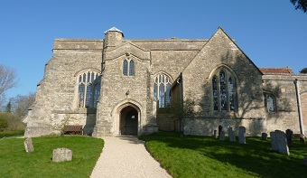
Welcome to the Chilton Church Quiz
Saturday 13th May 2017

Slide 2
Your Challenge
To try to accumulate at least 20,000 points over the next 8 rounds.

Slide 3
Celebrating TV Quiz Shows
A Question of Sport
Only Connect
University Challenge
Sale of the Century
Double your Money
Who Dares Wins
Pointless
Winner Takes All

Slide 4

A Question of Sport
2nd December 1968 – present day

Slide 5
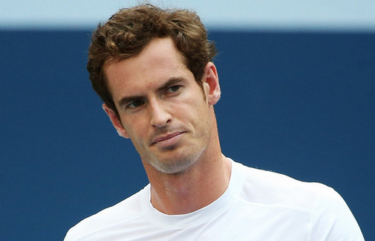
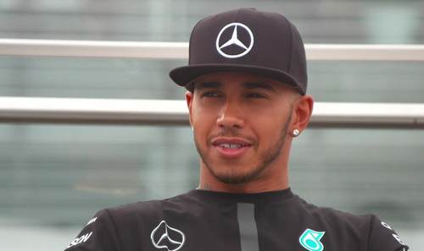
Question of Sport
Sports personality of the year
5 pts per competitor (Bonus 5 pts for their sport)
1 (2016) | 2 (2014)

Slide 6
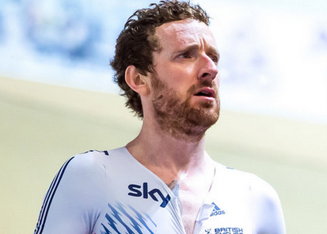
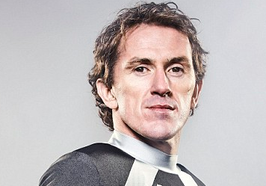
Question of Sport
Sports personality of the year
5 pts per competitor (Bonus 5 pts for their sport)
3 (2012) | 4 (2010)

Slide 7
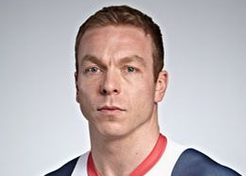
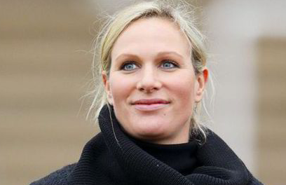
Question of Sport
Sports personality of the year
5 pts per competitor (Bonus 5 pts for their sport)
5 (2008) | 6 (2006)

Slide 8
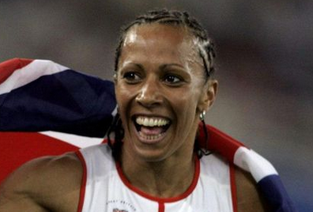
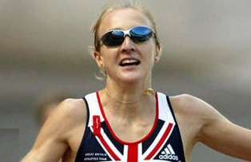
Question of Sport
Sports personality of the year
5 pts per competitor (Bonus 5 pts for their sport)
7 (2004) | 8 (2002)

Slide 9
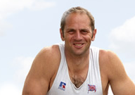
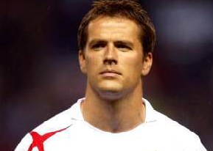
Question of Sport
Sports personality of the year
5 pts per competitor (Bonus 5 pts for their sport)
9 (2000) | 10 (1998)

Slide 10
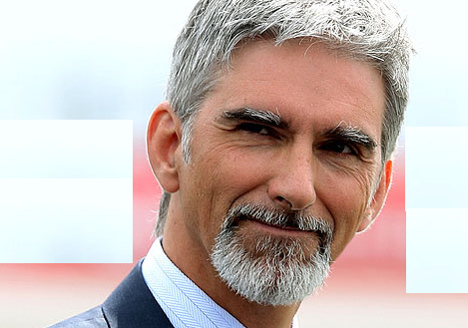
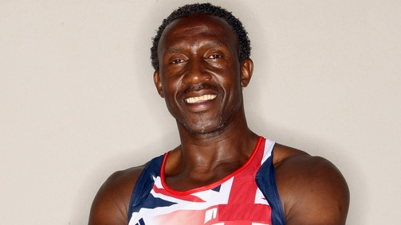
Question of Sport
Sports personality of the year
5 pts per competitor (Bonus 5 pts for their sport)
11 (1996) | 12 (1993)

Slide 11
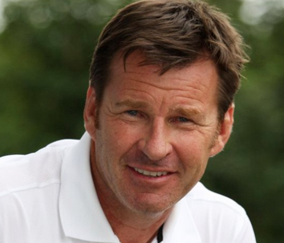
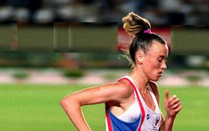
Question of Sport
Sports personality of the year
5 pts per competitor (Bonus 5 pts for their sport)
13 (1991) | 14 (1989)

Slide 12
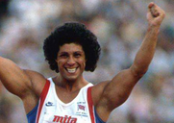
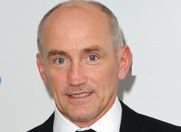
Question of Sport
Sports personality of the year
5 pts per competitor (Bonus 5 pts for their sport)
15 (1987) | 16 (1985)

Slide 13
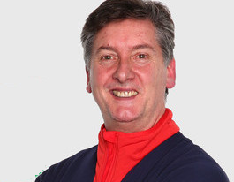
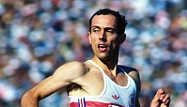
Question of Sport
Sports personality of the year
5 pts per competitor (Bonus 5 pts for their sport)
17 (1980) | 18 (1978)

Slide 14
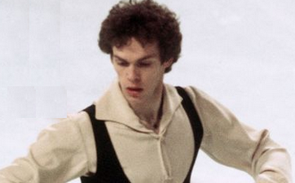
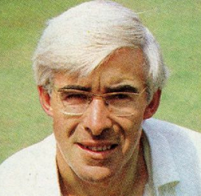
Question of Sport
Sports personality of the year
5 pts per competitor (Bonus 5 pts for their sport)
19 (1976) | 20 (1975)

Slide 15
5 pts per competitor (Bonus 5 pts per sport)
1 | Andy Murray | Tennis | 11 | Damon Hill | Motor Racing
2 | Lewis Hamilton | Motor Racing | 12 | Linford Christie | Athletics
3 | Bradley Wiggins | Cycling | 13 | Liz McColgan | Athletics
4 | Tony McCoy | Horse Racing | 14 | Nick Faldo | Golf
5 | Chris Hoy | Cycling | 15 | Fatima Whitbread | Athletics
6 | Zara Phillips | Eventing | 16 | Barry McGuigan | Boxing
7 | Kelly Holmes | Athletics | 17 | Robin Cousins | Figure Skating
8 | Paula Radcliffe | Athletics | 18 | Steve Ovett | Athletics
9 | Steve Redgrave | Rowing | 19 | John Curry | Figure Skating
10 | Michael Owen | Football | 20 | David Steele | Cricket

Slide 16
Your target
Your target was 150 points.
How did you do?

Slide 17
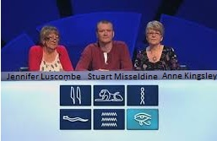
Only Connect
15th September 2008 – present

Slide 18
The Painted Wall
Listed below are 6 Christian names, 6 surnames, 6 dates of birth and 6 famous paintings.
Your task is to unjumble them.
1697 | Edwin | Constable | A Rake’s Progress 1732
1724 | George | Gainsborough | The Fighting Temeraire 1839
1727 | John | Hogarth | Monarch of the Glen 1851
1775 | Joseph | Landseer | Newmarket Heath 1765
1776 | Thomas | Stubbs | The Blue Boy 1779
1802 | William | Turner | The Hay Wain 1821

Slide 19
The Painted Wall
 | Edwin
 | George
 | John
 | Joseph
 | Thomas
 | William

Slide 20
The Painted Wall
Scoring system
6 lines to complete
Any wrong answer in a line scores 0
2 correct in a line scores 20 pts
3 correct in a line scores 40 pts
A fully correct line scores 100 pts
Maximum score for a fully completed wall 600 pts
Your target, at least 300 points

Slide 21
Examples
 | Edwin
1724 | Joseph
1727 | George | Hogarth
1775 | John | Turner | The Blue Boy
The top row scores 0;
The next row, if correct, scores 20 pts
The next row, if correct, scores 40 pts
The final row, if correct scores 100 pts

Slide 22
The Painted Wall generously sponsored by Chilton Estates
Meal voucher
1697 | Edwin | Constable | A Rake’s Progress 1732
1724 | George | Gainsborough | The Fighting Temeraire 1839
1727 | John | Hogarth | Monarch of the Glen 1851
1775 | Joseph | Landseer | Newmarket Heath 1765
1776 | Thomas | Stubbs | The Blue Boy 1779
1802 | William | Turner | The Hay Wain 1821

Slide 23
The Painted Wall sponsored by Chilton Estates
Let thinking time commence

Slide 24
The Painted Wall generously sponsored by Chilton Estates
1802 | Edwin | Landseer | Monarch of the Glen 1851
1724 | George | Stubbs | Newmarket Heath 1765
1776 | John | Constable | The Hay Wain 1821
1775 | Joseph | Turner | The Fighting Temeraire 1839
1727 | Thomas | Gainsborough | The Blue Boy 1779
1697 | William | Hogarth | A Rake’s Progress 1732

Slide 25
Your target
After completing this round your overall target was 450 points.
How well did you do?

Slide 26
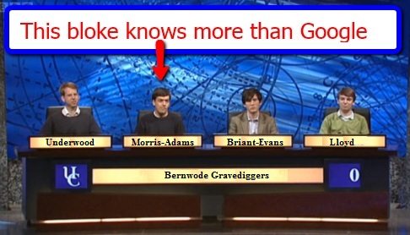
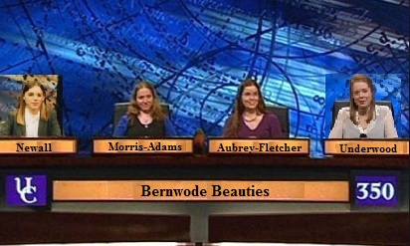
University Challenge
1962-1987 & 1994- present

Slide 27
University Challenge
Are the colleges in Oxford, Cambridge or Draw (both)
30 pts per correct answer; TOTAL SCORE OF ZERO on this round for even one incorrect answer.
Balliol |  | Magdalen
Christ Church |  | Magdalene
Christ’s |  | New College
Churchill |  | Oriel
Corpus Christi |  | Pembroke
Downing |  | St John’s
Emmanuel |  | Trinity
Jesus |  | Trinity Hall
Keble |  | Wadham
King’s |  | Wolfson

Slide 28
Your target
Your target on this round is 450 points
Let thinking time commence.

Slide 29
University Challenge
Kindly sponsored by Camp Farm
Are the colleges in Oxford, Cambridge or Draw (both)
30 pts per correct answer; TOTAL SCORE OF ZERO on this round for even one incorrect answer.
Balliol | O | Magdalen | O
Christ Church | O | Magdalene | C
Christ’s | C | New College | O
Churchill | C | Oriel | O
Corpus Christi | D | Pembroke | D
Downing | C | St John’s | D
Emmanuel | C | Trinity | D
Jesus | D | Trinity Hall | C
Keble | O | Wadham | O
King’s | C | Wolfson | D

Slide 30
Your target
Your target after completing this round was 900 points. How well did you do?

Slide 31

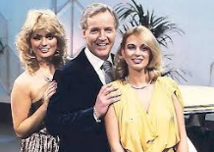
Sale of the Century
1972 – 1983

Slide 32
Sale of the Century
Winners share 1000 pts
4th Round losers 250 pts
3rd Round losers 120 pts
2nd Round losers 80 pts
First Round losers 40 pts
Your target is at least 250 points

Slide 33
John Lewis
All items are taken from the current John Lewis website.
They are items that are used from daybreak to nightfall.
You have a choice of 3 prices each round.

Slide 34
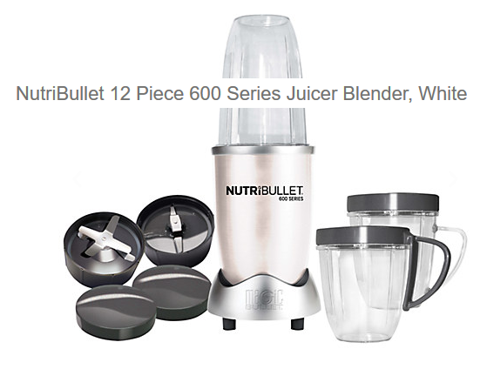
Sale of the century
Wake up to a smoothie in the morning
A Less than £50 B £50 C More than £50

Slide 35
Smoothie/Juicer
C £69.00
Losers get 40 pts

Slide 36
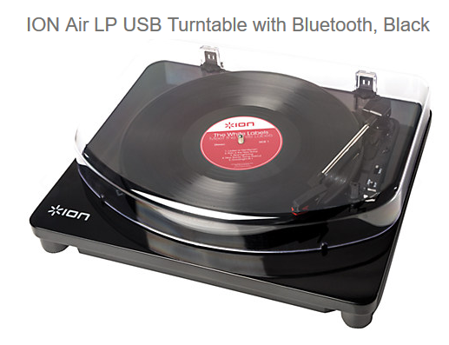
Sale of the Century
The ION Air LP Bluetooth turntable streams albums to any Bluetooth speaker. It’s the perfect solution to merging authenticity with the convenience of modern technology.
A Less Than £100
B £100
C More than £100

Slide 37
Record deck
A £99.50
Losers get 80 pts

Slide 38
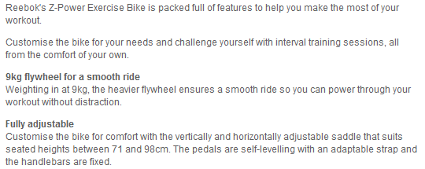
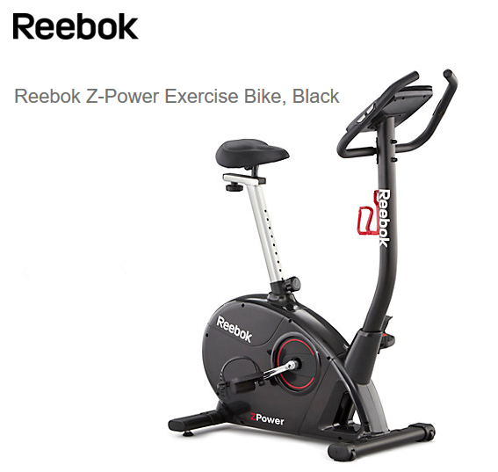
Sale of the Century
A Less than £400
B £400
C More than £400

Slide 39
Exercise Bike
A £299
Losers get 120 pts

Slide 40
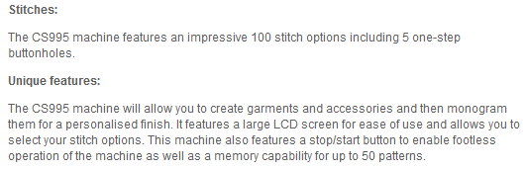
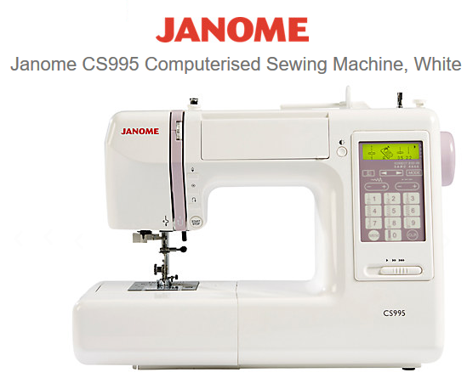
Sale of the Century
A Less than £495
B £495
C More than £495

Slide 41
Computerised Sewing Machine
C £499.50
Losers get 250 pts
Winners share 1000 pts

Slide 42
Your target
Your overall target to this point was 1150 points.
How well did you do?

Slide 43
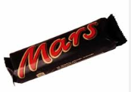
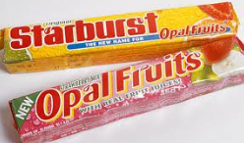
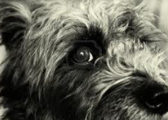
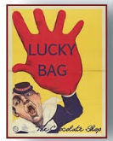
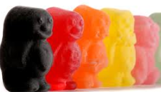

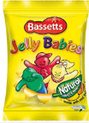
Half way through the show
Lucky

Slide 44
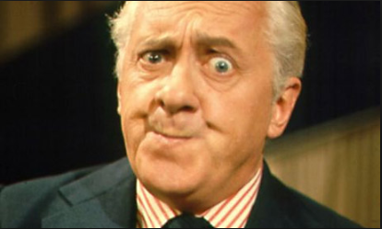
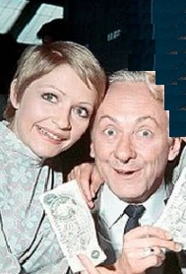
Double Your Money
1955 – 1968
Hughie Green
Monica Rose & Hughie Green

Slide 45
Double Your Money
Win from 20pts to 2,560 pts)
All questions relate to UK landmarks and their counties.
Answer 8 questions correctly to win 2,560 pts
You can quit whenever you like to claim your points before the next question is asked.
Your target is 1280 points

Slide 46
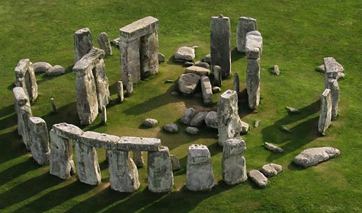
For 20 points
In which county is this?

Slide 47
Wiltshire
Double or Quits?

Slide 48
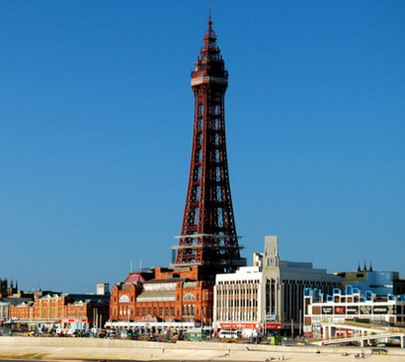
For 40 points
In which county is this?

Slide 49
Lancashire
Double or Quits?

Slide 50
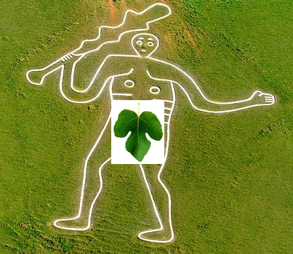
For 80 points
In which county is this?

Slide 51
Dorset
Double or Quits?

Slide 52
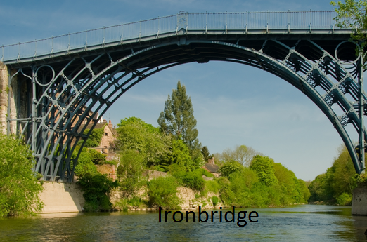
For 160 points
In which county is this?

Slide 53
Shropshire
Double or Quits?

Slide 54
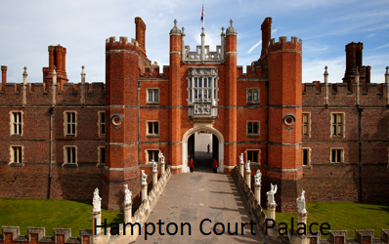
For 320 points
In which county is this (not Greater London)?

Slide 55
Surrey
Double or Quits?

Slide 56
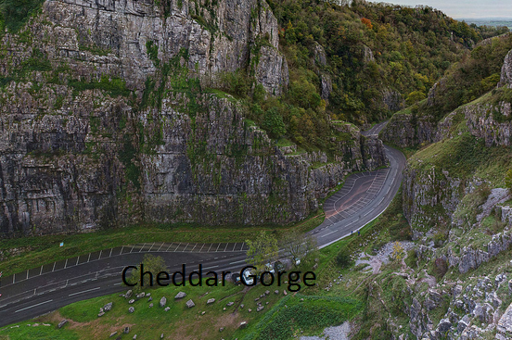
For 640 points
In which county is this?

Slide 57
Somerset
Double or Quits?

Slide 58
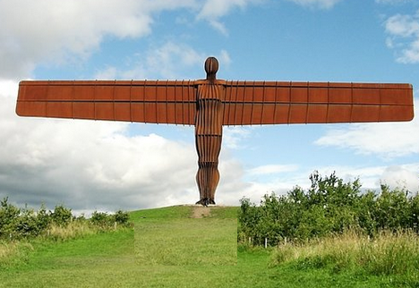
For 1,280 points
In which county is this?

Slide 59
Tyne & Wear
Double or Quits?

Slide 60
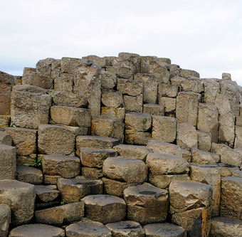
For 2,560 points
In which county is this?

Slide 61
County Antrim
Did you hit the jackpot?

Slide 62
Your target
Your overall target to this point was 2430 points
How well did you do?

Slide 63

Who Dares Wins
17th November 2007 - present

Slide 64
Who Dares Wins
The table contains 15 triplets. Your aim is to identify the team in each triplet which HAS NOT won the F A Cup.
3 correct = 100 pts
6 correct = 200 pts
9 correct = 400 pts
11 correct = 800 pts
13 correct = 1200 pts
All 15 correct = 2000 pts
Your target is at least 570 points

Slide 65
Who Dares Wins
2000 | Barnsley | Burnley | Bury
 | Birmingham City | Bradford City | Charlton
1500 | Huddersfield Town | Hull City | Ipswich Town
 | Cardiff City | Portsmouth | Swansea City
800 | Blackpool | Bournemouth | Derby County
 | Watford | Wigan Athletic | Wimbledon
400 | Leicester City | Notts County | Notts Forest
 | Luton Town | Sheffield Wed. | Sheffield United
 | Blackburn Rovers | Fulham | Preston NE
200 | Middlesbrough | Southampton | Sunderland
 | Coventry City | Millwall | West Ham
 | Bolton Wanderers | Stoke City | West Brom
100 | Aston Villa | Crystal Palace | Leeds United
 | Brighton | Newcastle Utd | Spurs
 | Everton | Liverpool | Queens Park R

Slide 66
Who Dares Wins
Let the thinking commence

Slide 67
Who Dares Wins
2000 | Barnsley | Burnley | Bury
 | Birmingham City | Bradford City | Charlton
1500 | Huddersfield Town | Hull City | Ipswich Town
 | Cardiff City | Portsmouth | Swansea City
800 | Blackpool | Bournemouth | Derby County
 | Watford | Wigan Athletic | Wimbledon
400 | Leicester City | Notts County | Notts Forest
 | Luton Town | Sheffield Wed. | Sheffield United
 | Blackburn Rovers | Fulham | Preston NE
200 | Middlesbrough | Southampton | Sunderland
 | Coventry City | Millwall | West Ham
 | Bolton Wanderers | Stoke City | West Brom
100 | Aston Villa | Crystal Palace | Leeds United
 | Brighton | Newcastle Utd | Spurs
 | Everton | Liverpool | Queens Park R

Slide 68
Your target
Your overall target to this point was 3000 points
How well did you do?

Slide 69
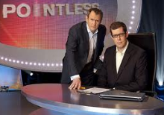
Pointless
24th August 2009 – present

Slide 70
Word Round
Think of a word in the Oxford English Dictionary ending in
ILT
The longer, more obscure your word the more points you will score.
Points from 20 to 2000 are available.
Your target is at least 500 points

Slide 71
Let thinking time commence

Slide 72
The Points Board
AGUILT | 800 | KILT | 260 | SPOILT | 160
ATILT | 820 | LILT | 280 | STILT | 210
BEQUILT | 840 | MILT | 860 | TILT | 90
BLOODGUILT | 2000 | NILT | 1200 | TWILT | 760
BUILT | 20 | OVERBUILT | 390 | UNBEGILT | 1600
CARVELBUILT | 1900 | OVERTILT | 440 | UNSPILT | 520
GILT | 200 | QUILT | 300 | UNSPOILT | 450
GUILT | 400 | REBUILT | 380 | UPHILT | 810
HILT | 220 | SILT | 100 | UPTILT | 830
INBUILT | 400 | SMILT | 1250 | VANDERBILT | 1950
JILT | 240 | SPILT | 180 | WILT | 50

Slide 73
Your target
Your overall target to this point was 3500 points
How well did you do?
Now it’s on to the main target of at least 20,000 points

Slide 74
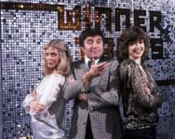
Winner Takes All
1975 – 1988
You are asked a question and given 5 possible answers. You choose and answer and can gamble up to half of your current points on the answer. If correct you gain those points. If incorrect you lose them.

Slide 75
7) Which is the only country in the world which does not have a divorce law?
A | Saudi Arabia
B | United Arab Emirates
C | Kuwait
D | Philippines
E | Qatar

Slide 76
7) Which is the only country in the world which does not have a divorce law?
A | Saudi Arabia
B | United Arab Emirates
C | Kuwait
D | Philippines
E | Qatar

Slide 77
6) What is the TOTAL number of letters in the titles of these Dickens books?
T… O… C… S…
B… H….
T… M… O. E… D..
L… D…
M… C….
A | 78
B | 79
C | 80
D | 81
E | None of these

Slide 78
6) What is the TOTAL number of letters in the titles of these Dickens books?
The Old Curiosity Shop 19
Bleak House 10
The Mystery of Edwin Drood 22
Little Dorrit 12
Martin Chuzzlewit 16
A | 78
B | 79
C | 80
D | 81
E | None of these

Slide 79
5) How old was William Pitt the Younger when he first became Prime Minister?
A | 24
B | 26
C | 28
D | 30
E | 32

Slide 80
5) How old was William Pitt the Younger when he first became Prime Minister?
A | 24
B | 26
C | 28
D | 30
E | 32

Slide 81
4) Listed below are 5 countries and 5 capitals, but how many are CORRECT?
Australia (Sydney)
Brazil (Rio de Janeiro)
Canada (Ottawa)
Lesotho (Maseru)
Suriname (Paramaribo)
A | 0
B | 1
C | 2
D | 3
E | 4

Slide 82
4) Listed below are 5 countries and 5 capitals, but how many are CORRECT?
Australia (Sydney)
Brazil (Rio de Janeiro)
Canada (Ottawa)
Lesotho (Maseru)
Suriname (Paramaribo)
A | 0
B | 1
C | 2
D | 3
E | 4

Slide 83
3) Who is currently 9th in line to the throne?
A | Princess Anne
B | Viscount Severn
C | Lady Louise Windsor
D | Prince Edward
E | Princess Eugenie

Slide 84
3) Who is 9th in line to the throne?
Prince Charles Prince William
Prince George Princess Charlotte
Prince Harry Prince Andrew
Princess Beatrice Princess Eugenie
Prince Edward
A | Princess Anne
B | Viscount Severn
C | Lady Louise Windsor
D | Prince Edward
E | Princess Eugenie

Slide 85
2) Who wrote the lyrics of ‘Land of Hope & Glory’?
A | Arthur Benson
B | Edward Elgar
C | William Blake
D | Robbie Burns
E | Dr Henry Carey

Slide 86
2) Who wrote the lyrics of ‘Land of Hope & Glory’?
A | Arthur Benson
B | Edward Elgar
C | William Blake
D | Robbie Burns
E | Dr Henry Carey

Slide 87
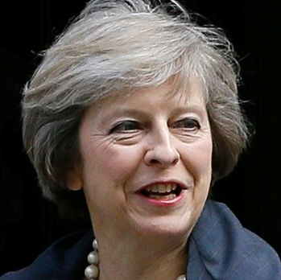




1) If the politicians below were listed in age order, who would be in the middle?
A | Theresa May
B | Jeremy Corbyn
C | Nicola Sturgeon
D | Leanne Wood
E | Tim Farron

Slide 88
1) If the politicians below were listed in age order, who would be in the middle?
A | Theresa May 60 (1/10/56)
B | Jeremy Corbyn 67 (26/5/49)
C | Nicola Sturgeon 46 (19/7/70)
D | Leanne Wood 45 (13/12/71)
E | Tim Farron 46 (27/5/70)

Slide 89
And finally!!
Did you meet the challenging target of 20,000 points?

Slide 90
That’s all folks!
Why not try the other quizzes on
www.greyhoundderby.com

